Slide 1

Watson Assistant Labs
Lab 3: Understanding User Sentiment - Integrating Watson Natural Language Understanding

Slide 2
Objective
Extend your chatbot to provide a new function
Allow the user to submit a review of a phone and respond based on user sentiment
Use Watson Assistant option response to prompt the user
Introduce Watson Natural Language Understanding (NLU)
Sentiment analysis
Emotion analysis
Extracting entities, keywords and concepts
Use IBM Cloud Functions to integrate Watson NLU into your chatbot

Slide 3
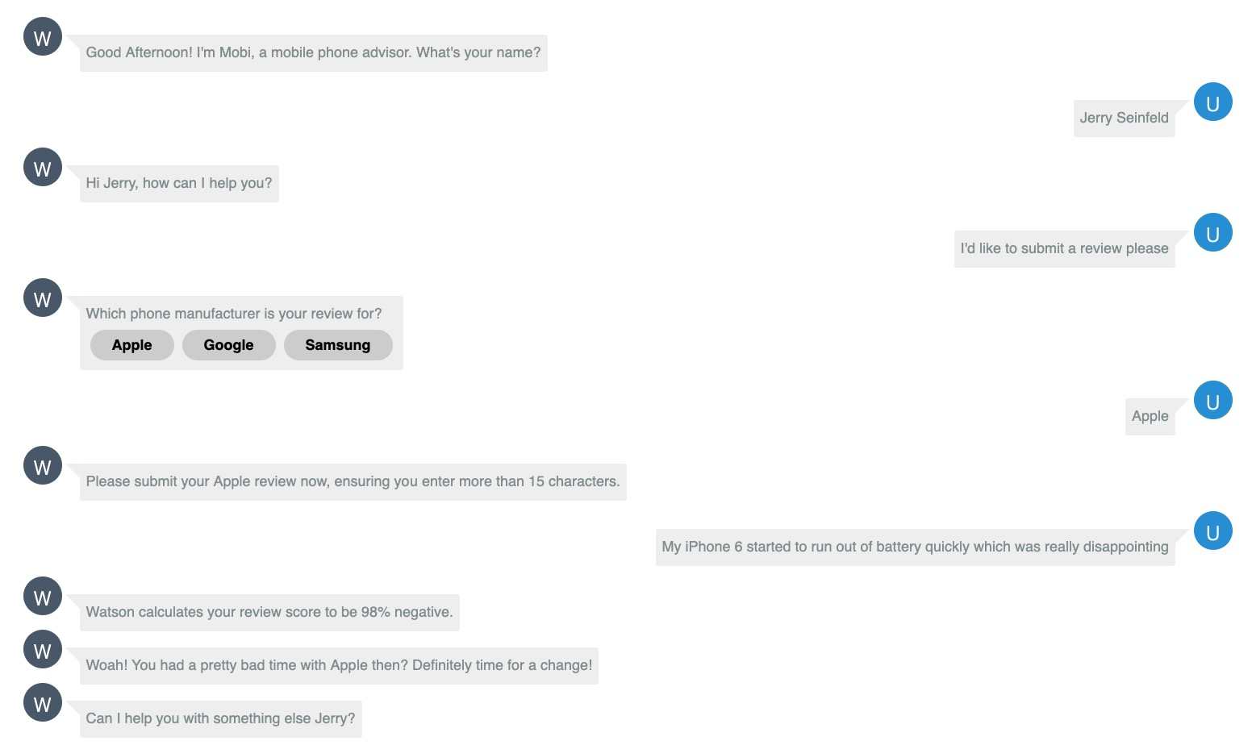
Objective

Slide 4
Agenda
Introduction to Watson NLU
Setup an IBM Watson NLU instance
Create Sentiment Analysis IBM Cloud Function
Setup Watson Assistant to use IBM Cloud Functions
Create Submit Review intent and dialog

Slide 5
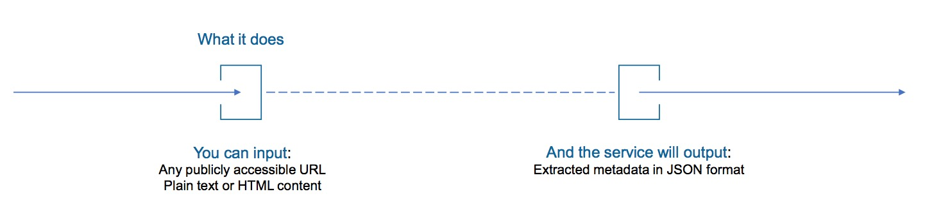
Watson Natural Language Understanding
Easy to use semantic text analysis service
Uncovers insights from structured and unstructured data
extracts metadata from content such as concepts, entities, keywords, categories, relations and semantic roles
Understand sentiment and emotion
Use cases
monitor sentiment and emotion in customer support chat transcripts
categorise blog posts - sort them based on general concepts, keywords, and entities
Full support for English, partial support for Arabic, Chinese, Dutch, French, German, Italian, Japanese, Korean, Portuguese, Russian, Spanish, Swedish

Slide 6
Watson Natural Language Understanding
Passed to NLU
Response based on sentiment

Slide 7
IBM Cloud Functions
With IBM Cloud Functions you can:
lightweight code that executes application logic in a scalable way
run this code on-demand via requests from applications or automatically in response to events
How we might use an IBM Cloud Function from within Watson Assistant?
Validate information you collect from a user
Perform calculations or string manipulations on user input that are too complex for expressions to handle
Interact with an external web service to get information, e.g. check on the expected arrival time for a flight from an air traffic service
Send requests to an external application, e.g. restaurant reservation site, to complete a simple transaction on the user's behalf

Slide 8
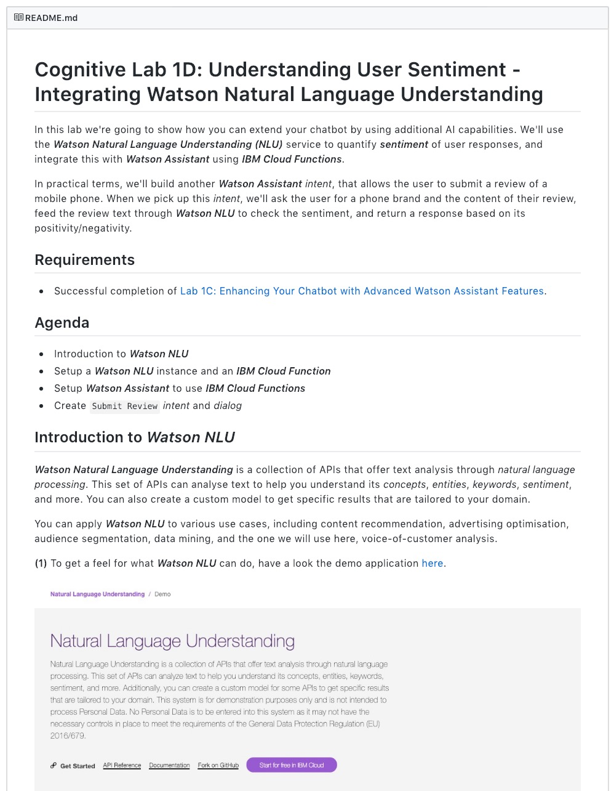
Lab Format
Step-by-step instructions
GitHub README.md for each lab
Work at your own pace
https://github.com/jenni-hautojarvi/Watson-Assistant-Labs/tree/master/3-Sentiment

Slide 9
Watson Assistant Labs
Lab 3: Understanding User Sentiment - Integrating Watson Natural Language Understanding

